Slide 1

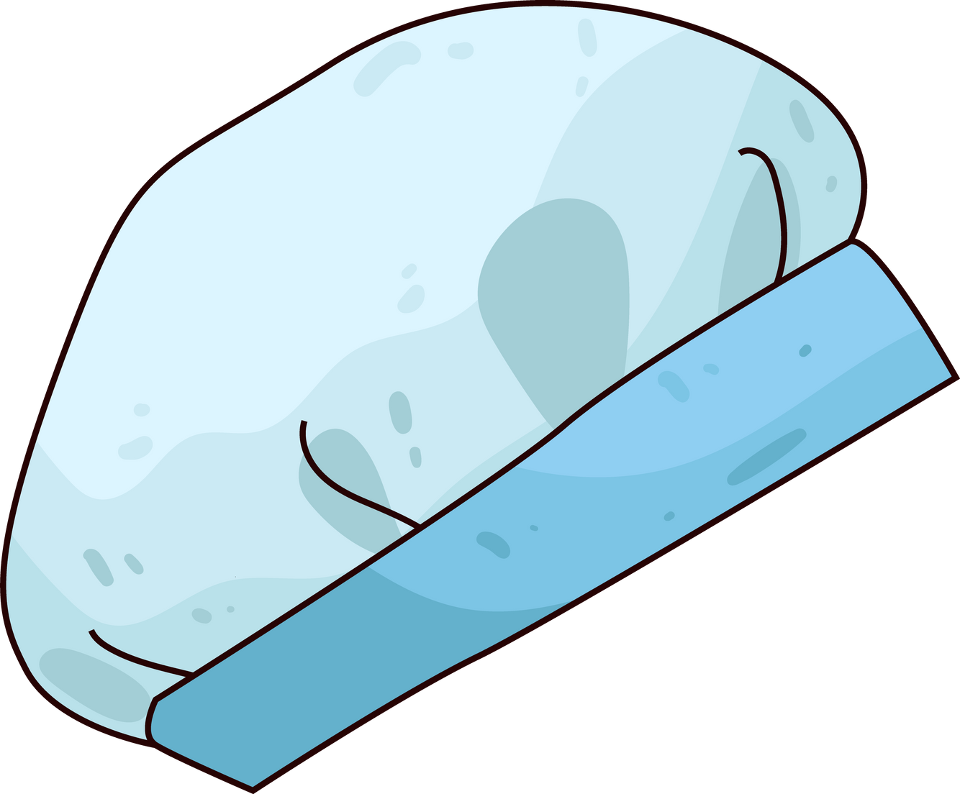

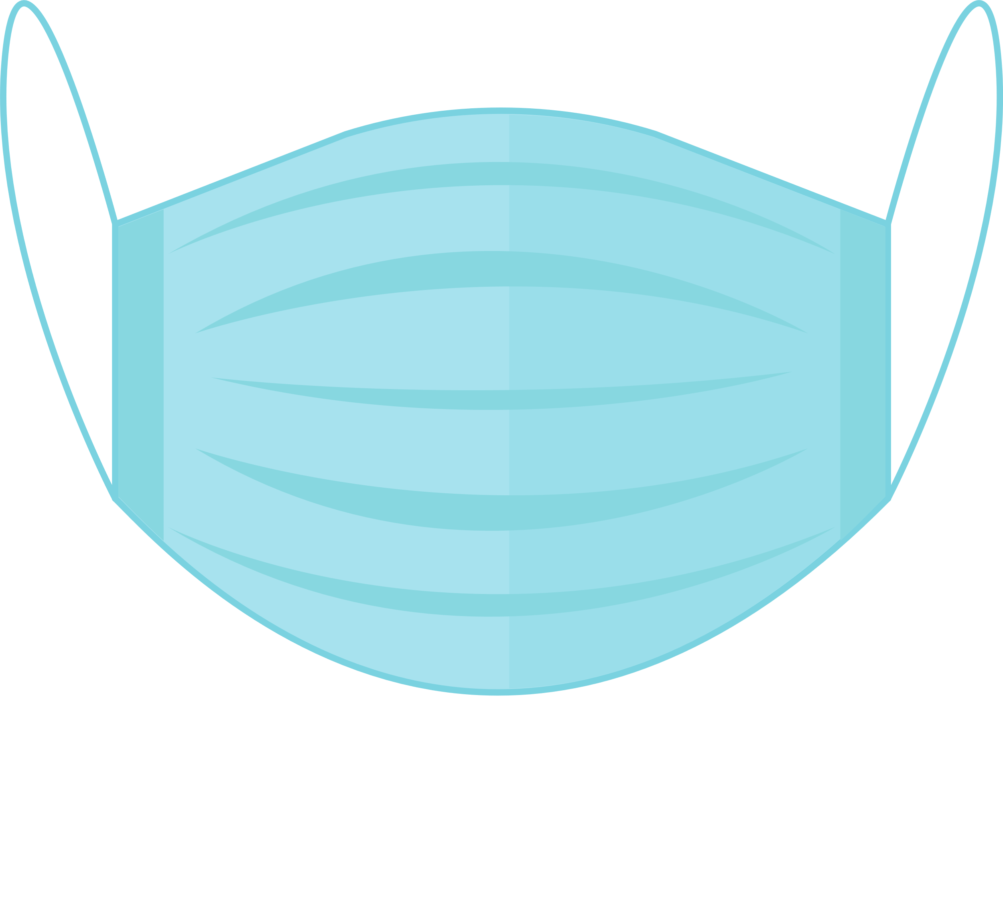

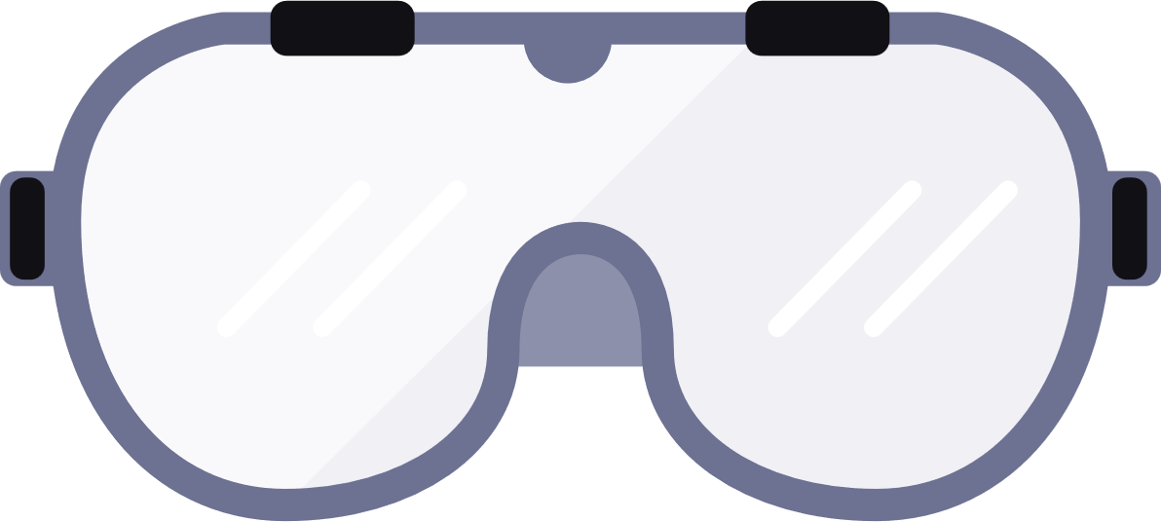
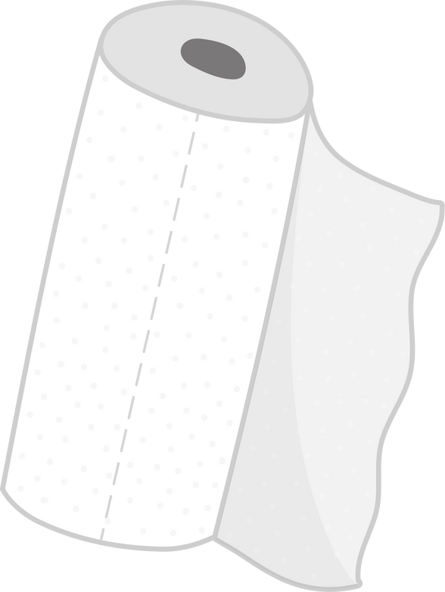
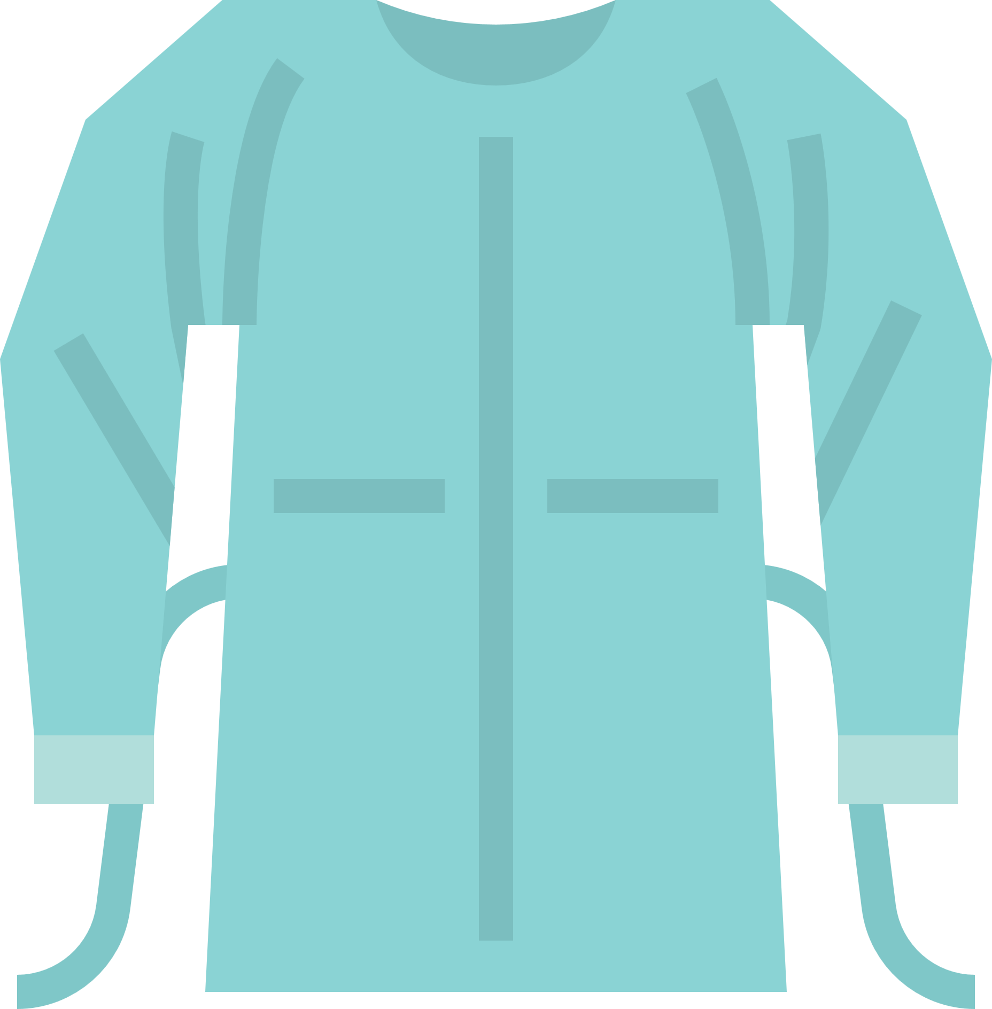

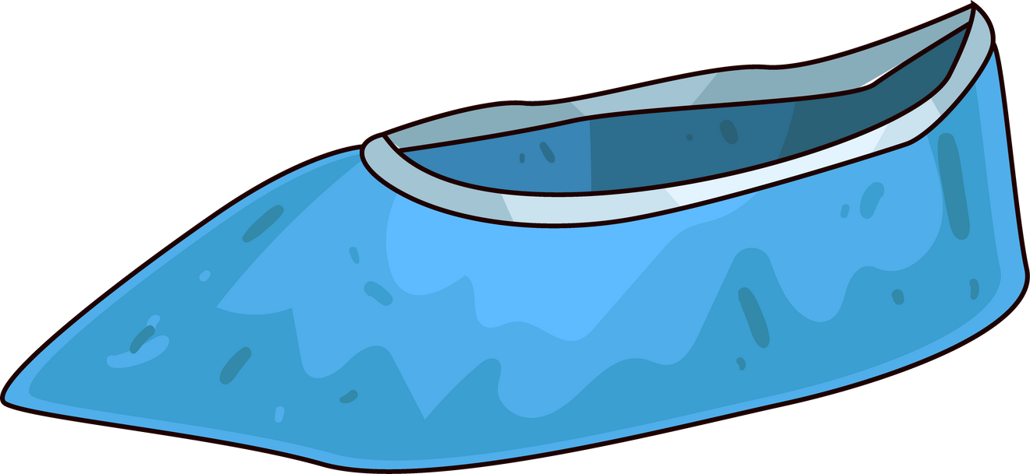
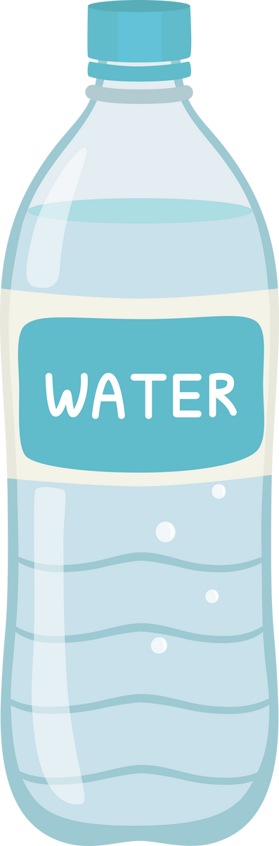



Hair Covering
Hard Hat
Game: Help Bob Prepare to Clean up Blood
Around the screen, you’ll find items that Bob may need to put on to clean up a spill that may contain BBP.
Click “edit” on the PowerPoint page, and slide the items Bob needs to get him properly dressed for this action.
If dragging isn’t working, just circle the items.
Mask/Mouth Cover
Safety Goggles
Headphones
Paper Towels
Traffic Cone
Shoe Covers
Notebook
Clothing Cover
Nitrile Gloves
Bleach Solution
Water Bottle

